Slide 1
MongoDB Modelling

Slide 2
Modelling Options for Relationships
1-1 relationships
Embed one object in the other
{
name,
email,
address: {
street,
number
}
}

Slide 3
Modelling Options for Relationships
1-* relationships
Child → Parent Reference
Parent → Child References
Embed Parent in Child
Embed Children in Parent

Slide 4
Modelling Options for Relationships
*-* relationships
Array of foreign-key references
Embed related objects

Slide 5
Modelling Options for Relationships
Trade-Offs
Embed → less operations but risks duplication
Reference → bounded docs but requires $lookup or multiple queries.

Slide 6
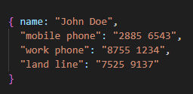
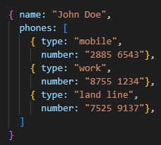
Design Patterns
Embedding
Attribute
{
name,
email,
address: {
street,
number
}
}

Slide 7
Design Patterns
Computed
{ title: "Alien",
year: 1979,
"average score": 8.5,
reviews: [{score: 7}, …]
}
Extended Reference
[
{
role: ObjectId("AB53-…"),
title: "Alien³",
score: 6.4,
character: "Ripley",
year: 1992
},
…
]

Slide 8
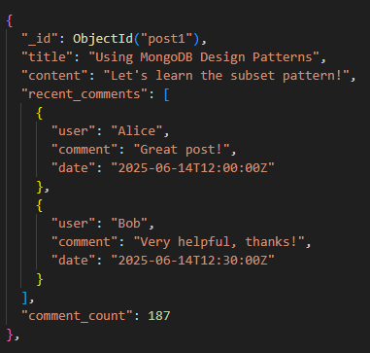
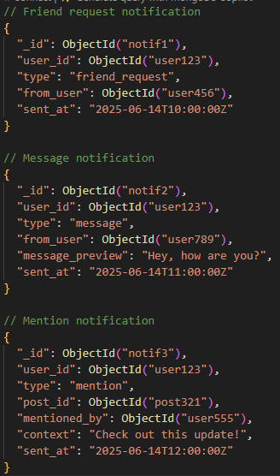
Design Patterns
Subset
Polymorphic

Slide 9
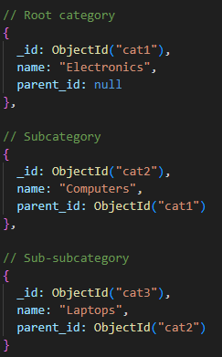
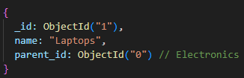
Design Patterns
Recursive
Tree

Slide 10
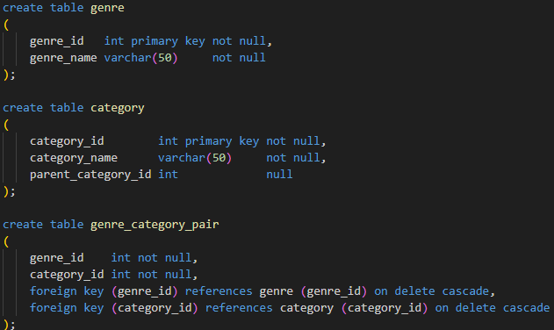
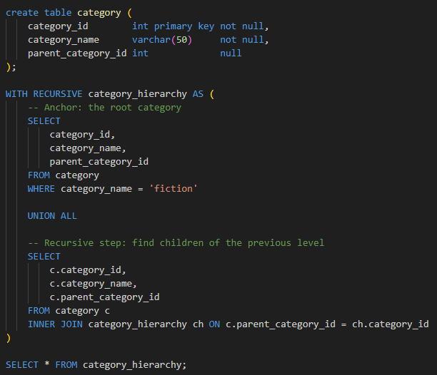
Comparing SQL vs. Document vs. Graph
SQL

Slide 11
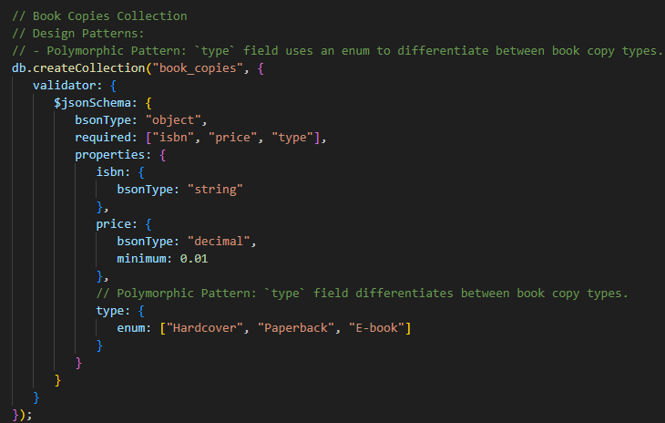
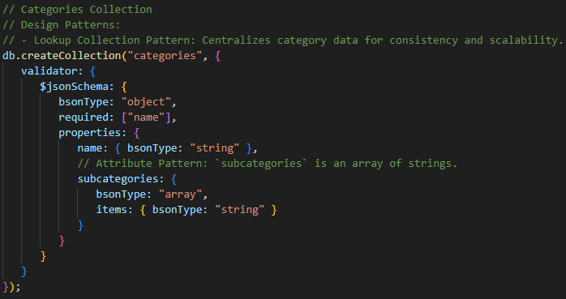
Comparing SQL vs. Document vs. Graph
Document

Slide 12
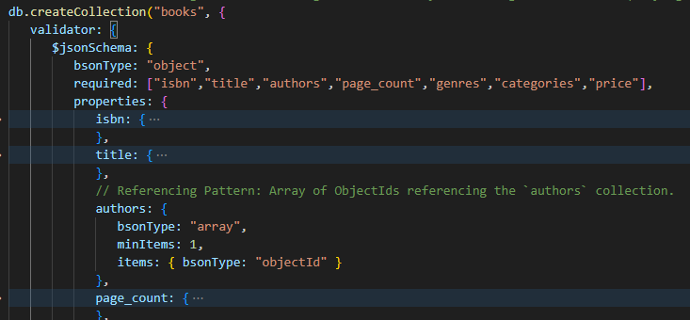
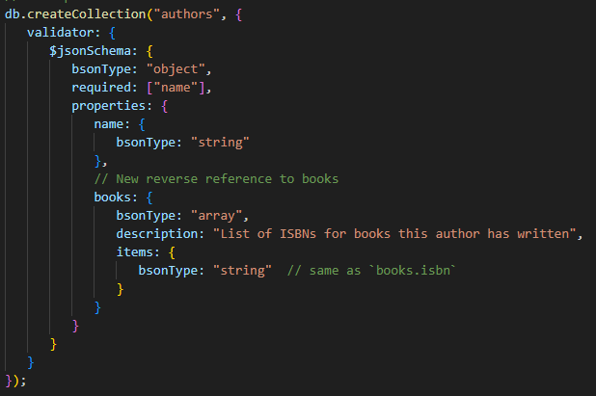
Comparing SQL vs. Document vs. Graph
Document

Slide 13
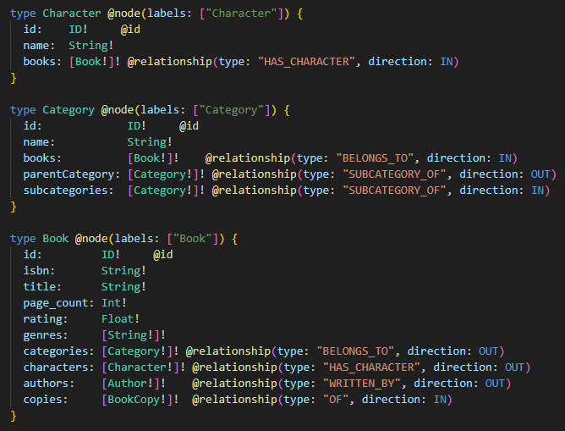
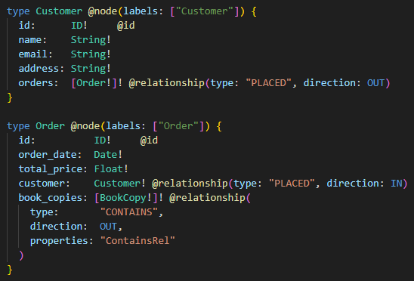
Comparing SQL vs. Document vs. Graph
Graph

